Slide 1
Characteristic Mode Analysis (CMA) of DRA
Kai FU
15-2-2023
ece.kaifu@my.cityu.edu.hk

Slide 2
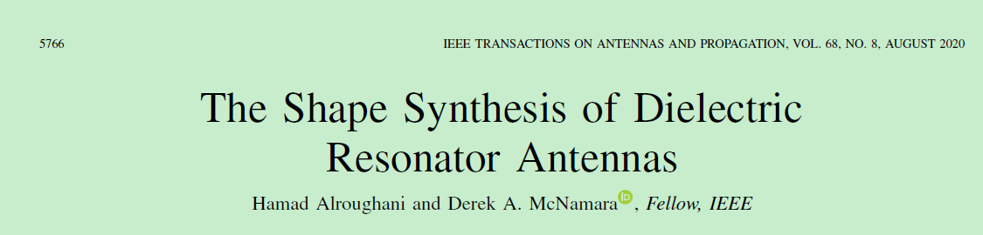
Main References

Slide 3
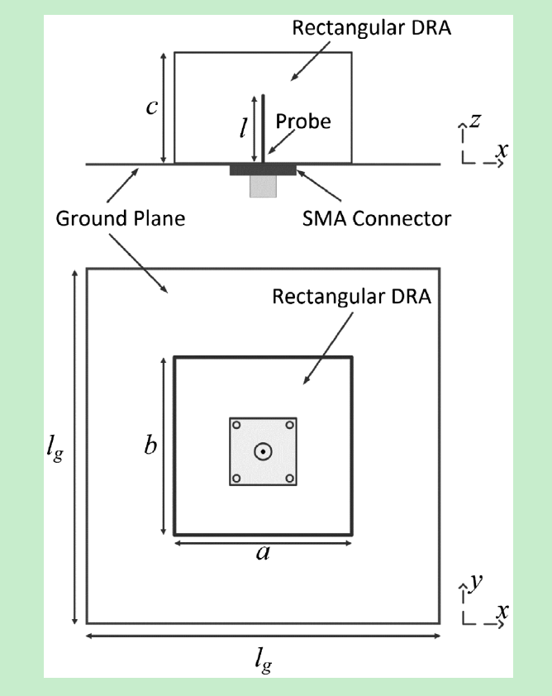
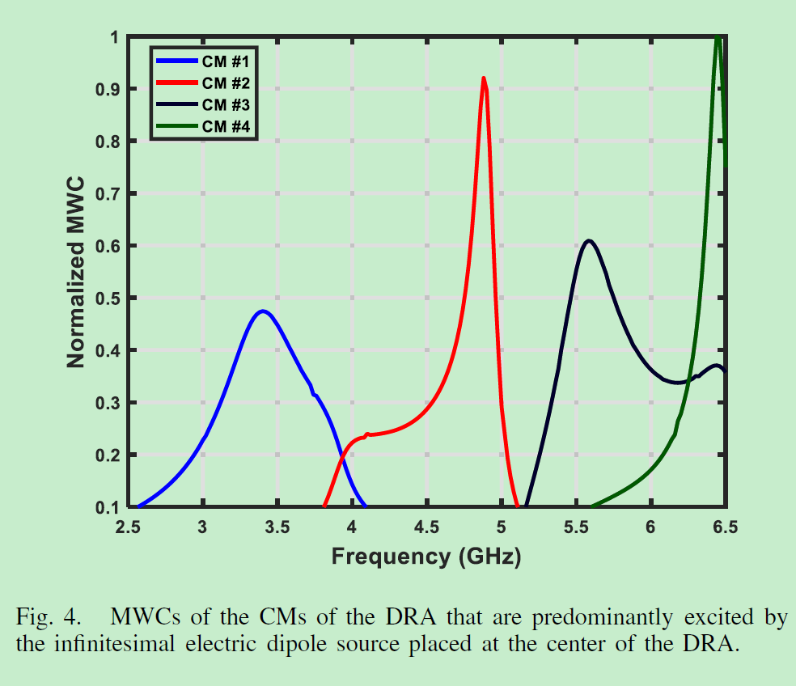
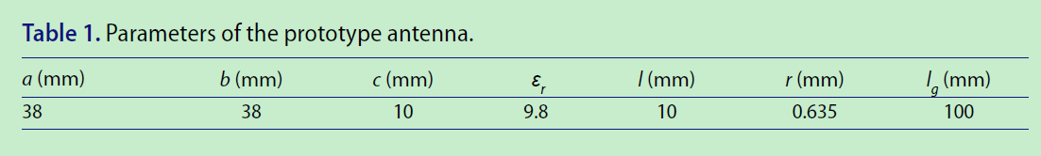
Aim: Reproduce Fig. 4

Slide 4
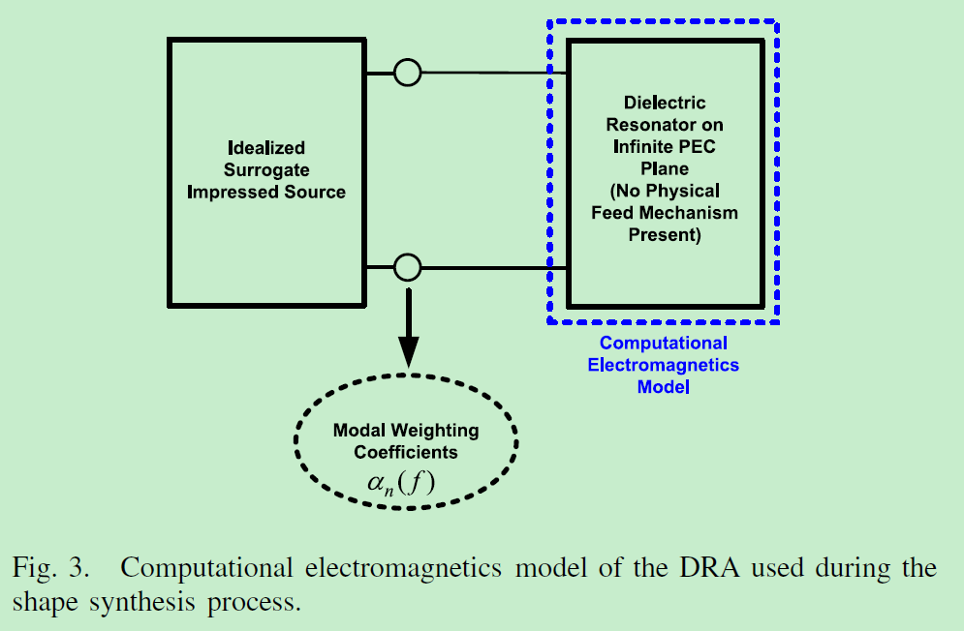
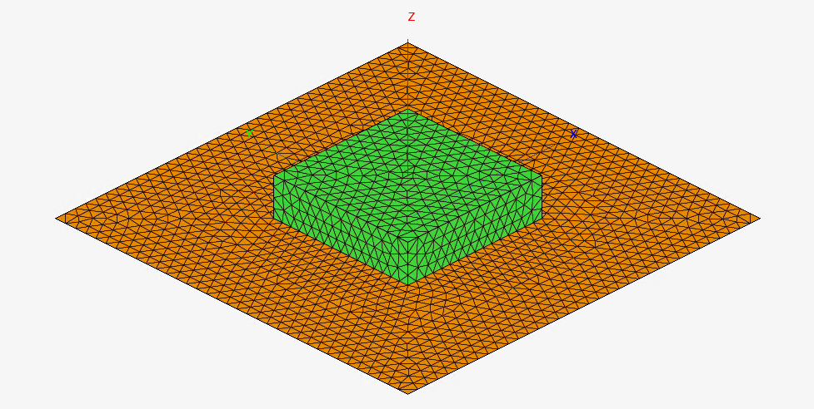
If it is a probe, we will represent it by a surrogate infinitesimal electric dipole.
If it is a slot, we will represent it by a surrogate infinitesimal magnetic dipole.

Slide 5
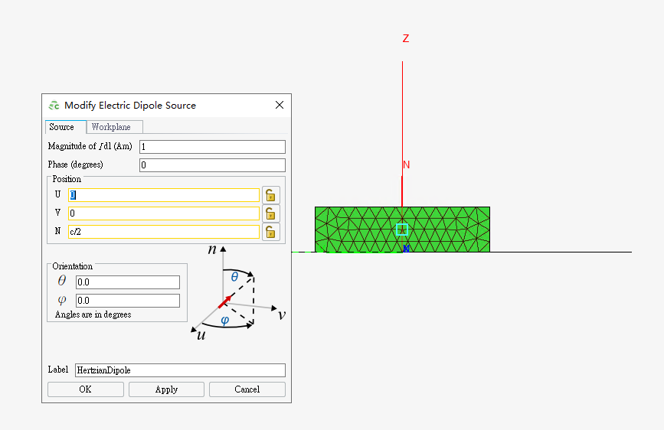
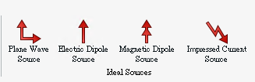
Feko provides several ideal sources
Note: not supported by CST and HFSS
E-Dipole for example

Slide 6
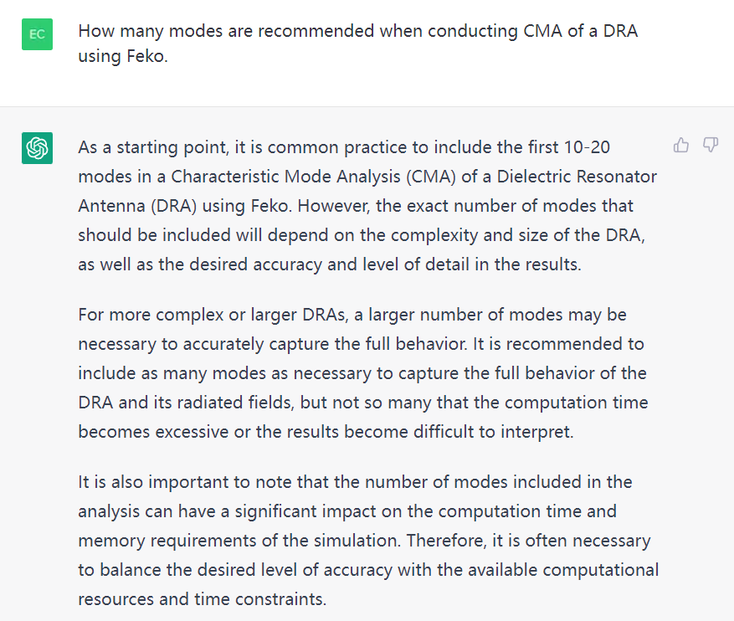
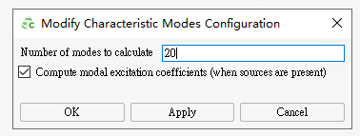
How many modes should be specified?

Slide 7
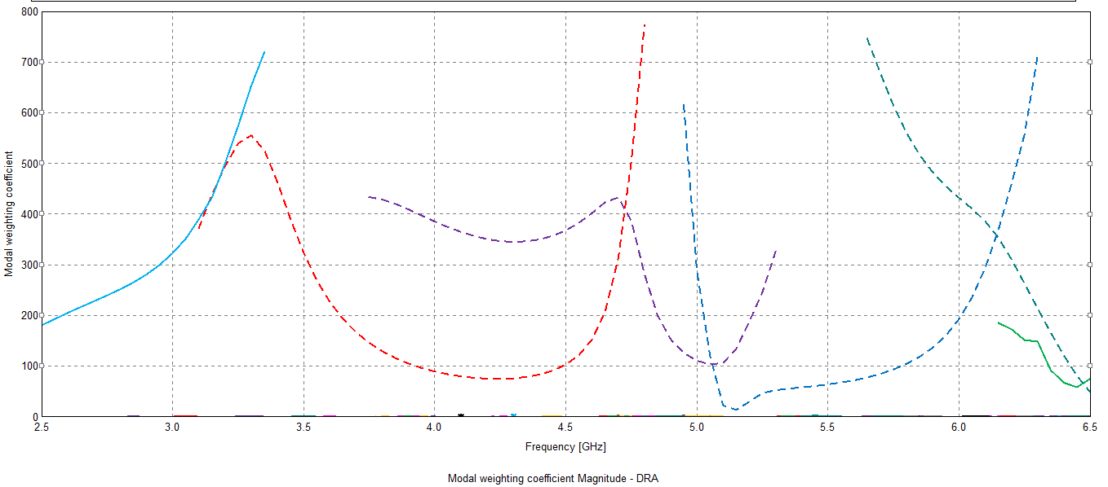
All 20 modes (frequency step = 50 MHz)

Slide 9
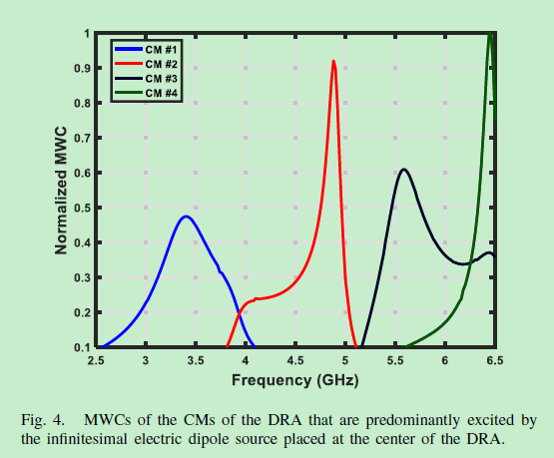
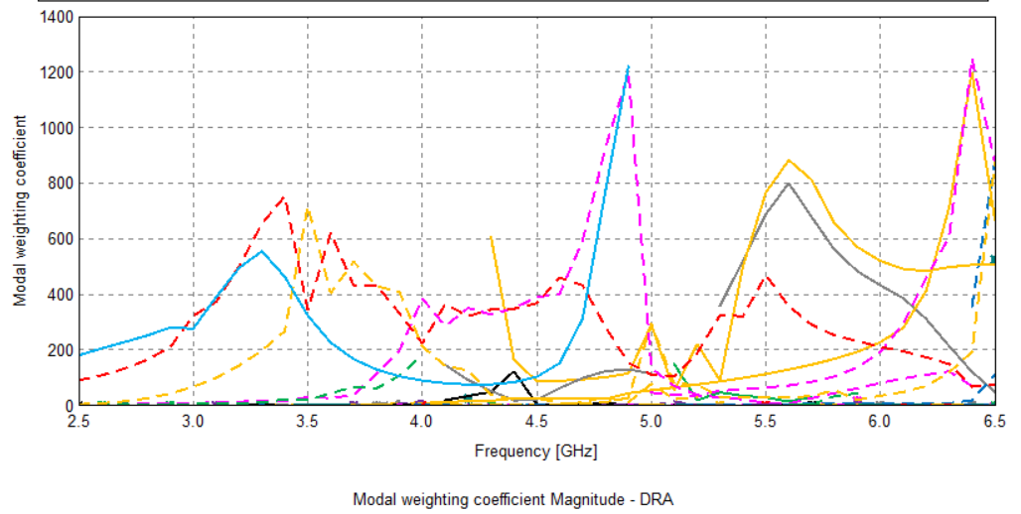
All 400 modes (frequency step = 100MHz)

Slide 10
Postprocessing: step 1 (normalization)

Slide 11
Postprocessing: step 2 (pruning)

Slide 12
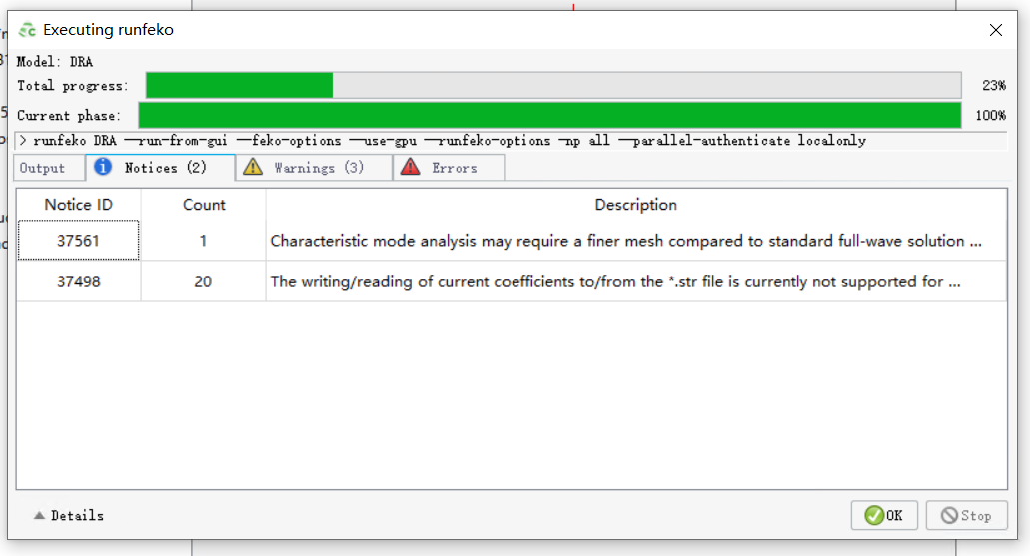
200 modes (frequency step = 50 MHz)

Slide 13
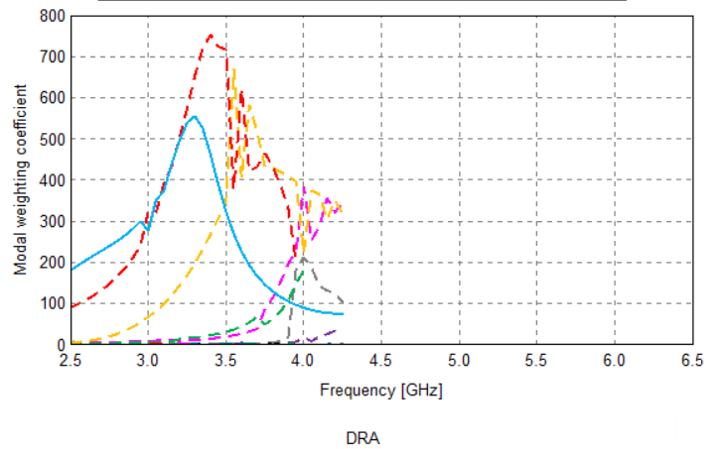
All 200 modes (frequency step = 50 MHz)

Slide 14
All 200 modes (frequency step = 50MHz)

Slide 15
All 100 modes (frequency step = 50MHz)

Slide 16
Conclusion
Accuracy
Trade-off
Computational Time
Three critical factors:
Mesh size
Frequency Points
Number of modes

Slide 17
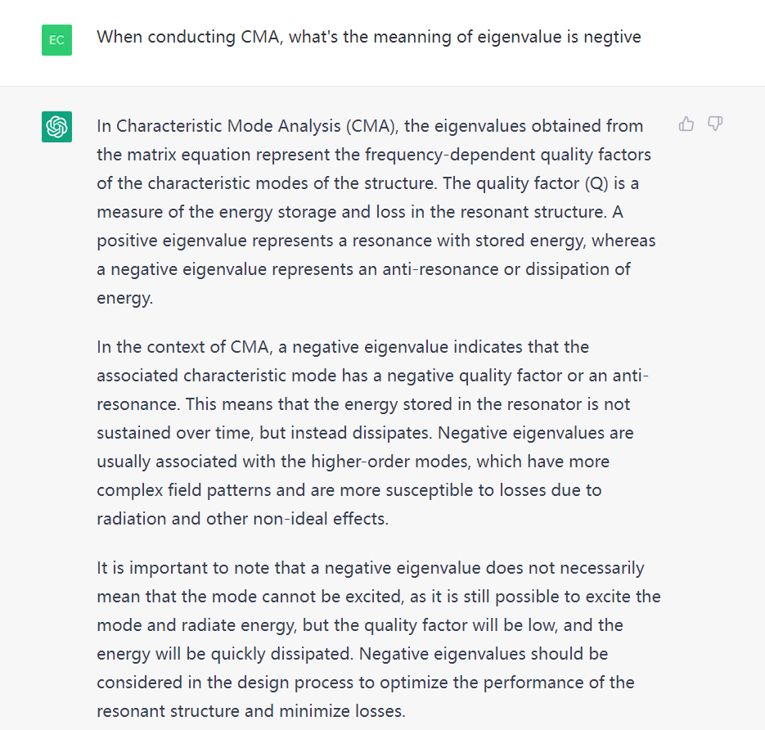

Slide 18
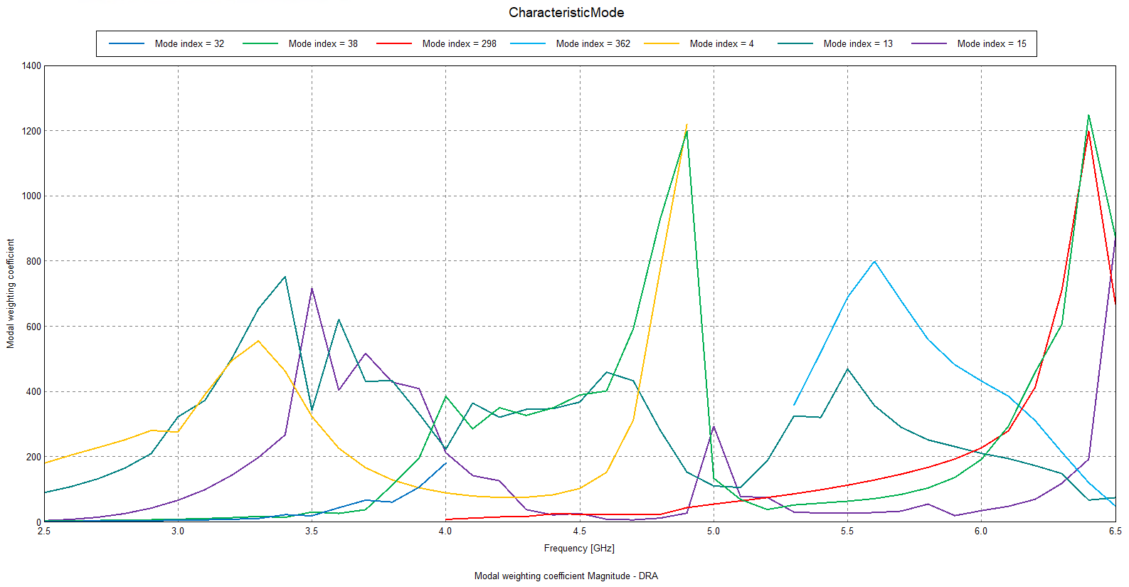
Selected modes with negative Eigenvalues

Slide 19
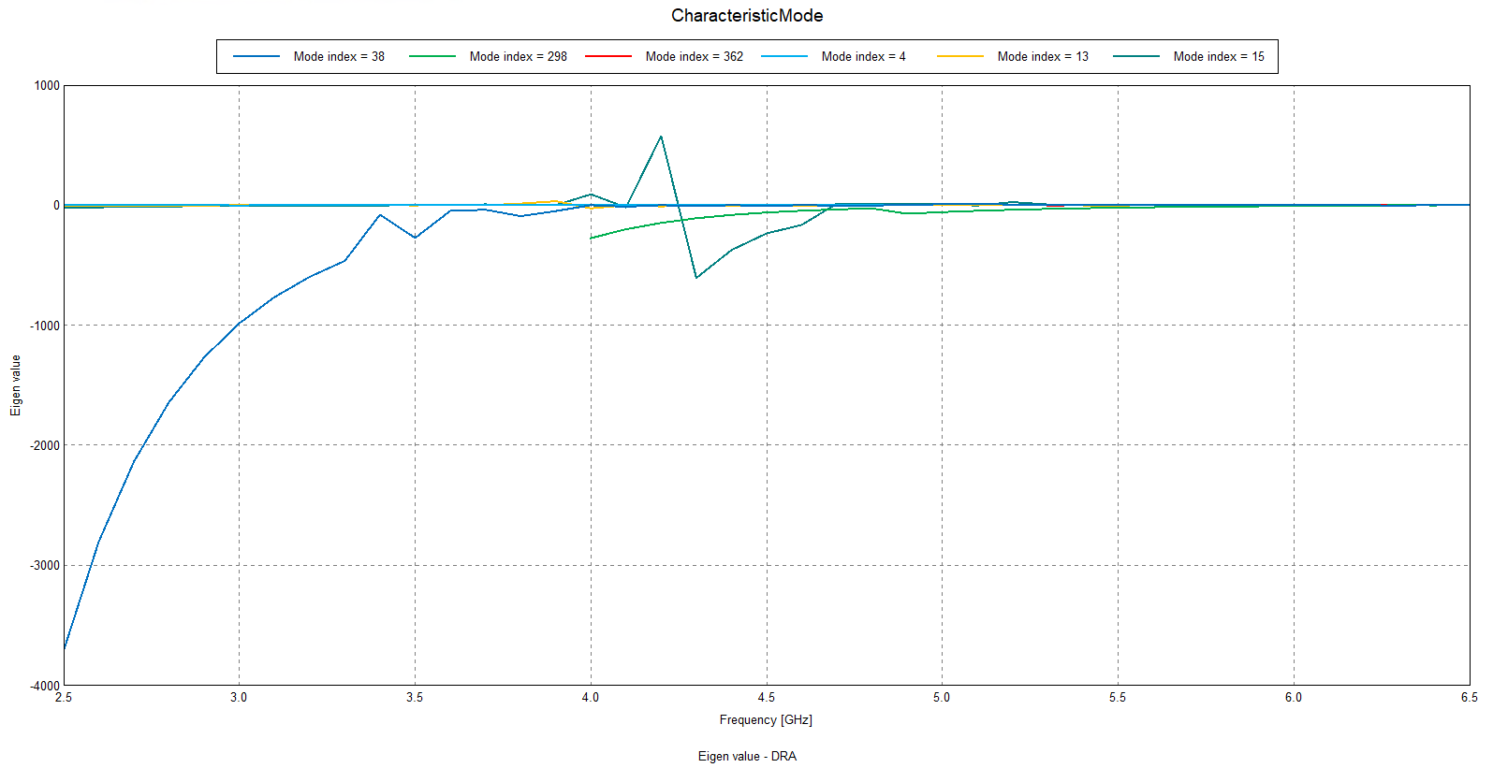
Eigenvalue

Slide 20
Postprocessing

Slide 21
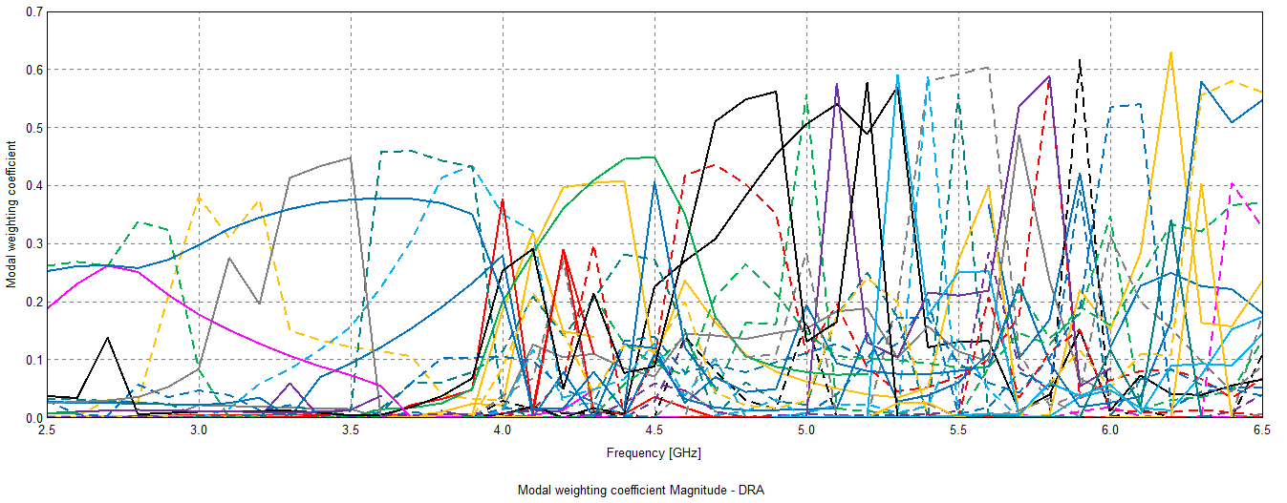
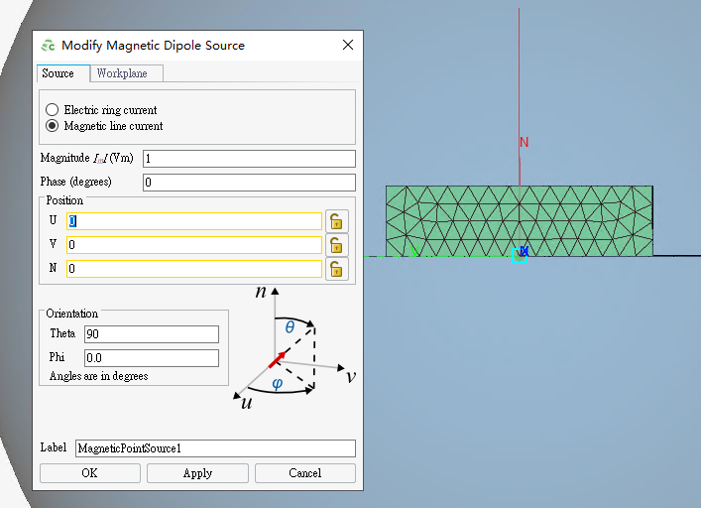
Theta = 90

